Slide 1
Data Science: Clinical Bionformatics and Genetic Association Studies
Alberto
Brusati

Slide 2
Introduction:
Clinical Bioinformatics
“Clinical bioinformatics is an area of healthcare science responsible for developing and improving methods for acquiring, storing, organising and analysing biological data that supports the delivery of patient care.”
“Staff working in clinical bioinformatics use areas of computer science including software tools that generate useful biological knowledge by manipulating ‘big data’ ”
Informatics in health care science is broken down into different areas:
clinical bioinformatics (genomics)
clinical bioinformatics (health informatics)

Slide 3
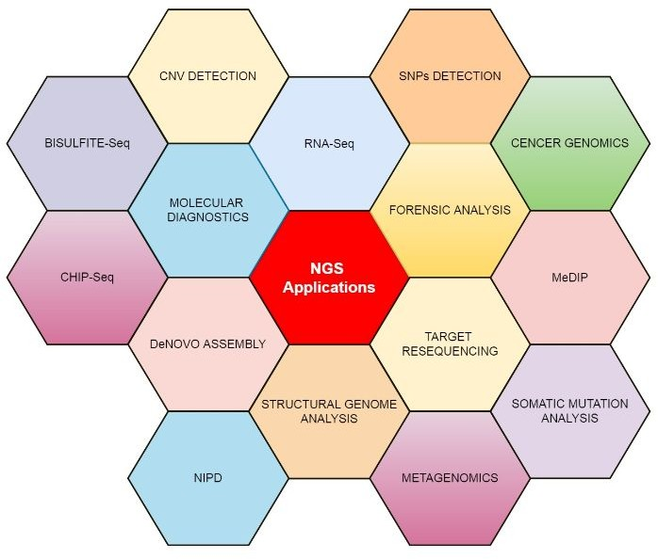
NGS Applications

Slide 4
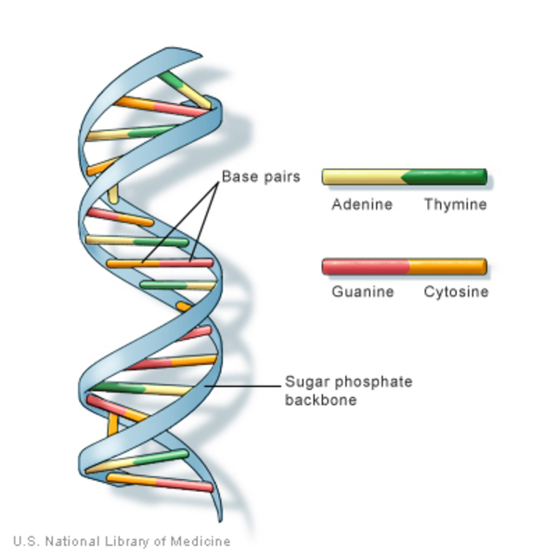
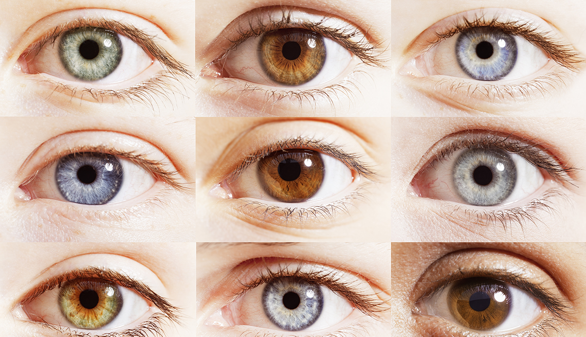
Biological background
genotype
phenotype
A mendelian trait is one that is controlled by a single locus, while complex phenotypes may be influenced by multiple variants in the genome. AIM: analyze genetic variability!

Slide 5
Type of genetic variability
Single base-pair substitution
These are also known as single nucleotide polymorphisms (SNPs) and can be any nucleic acid substitution:
Transition
interchange of the purine (Adenine/Guanine)
or pyrimidine (Cytosine/Thymine) nucleic acids
Transversion
interchange of a purine and pyrimidine nucleic acid
Insertion or deletion, also known as ‘indel’
Insertion or deletion of a single stretch of DNA sequence that can range from two to hundreds of base-pairs in length.
Structural variation
Typically used to describe genetic variation that occurs over a larger DNA sequence (example CNV!!!!!!!!!!!!).

Slide 6
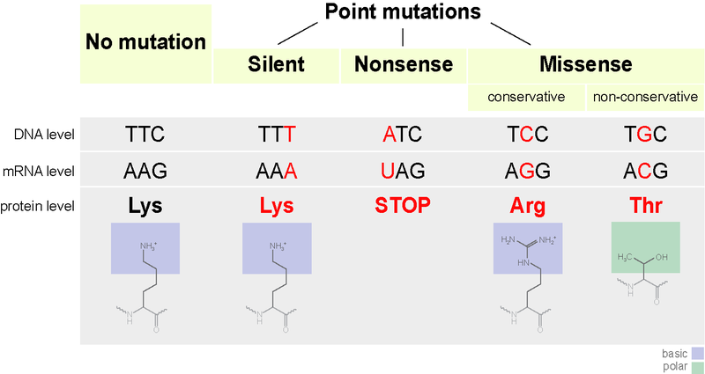
Effects of genetic variability
SYN
NON-SYN
Indels with a length divisible by three (i.e. whole codon indels) in coding regions will cause insertions or deletions of whole amino acids into the protein, and are known as in-frame deletions or insertions.
If the length is not divisible by three, this will cause a frameshift where all codons downstream of the indel are shifted.

Slide 7
Effects of genetic variability: protein level
The effects of variants on protein structure can vary dramatically depending on the type of protein and the extent of variation.
core level: change of conformation and unfolding
surface level: protein-protein, or protein-nucleic acid interactions, any variation of amino acids on the binding surface could lead to a loss of function.

Slide 8
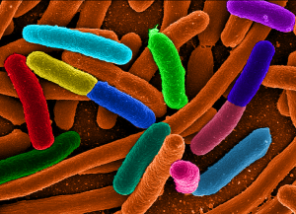
Variations in prokaryotes: a key of evolution
Prokaryotes tend to have haploid genomes, meaning that they only have one copy of each gene per individual.
Prokaryotes reproduce clonally (i.e. by making an exact copy of the cell), so recombination does not occur as a matter of course at every generation.
Prokaryotes typically reproduce much more rapidly than eukaryotes, and these short generation times can lead to more rapid adaptation.

Slide 9
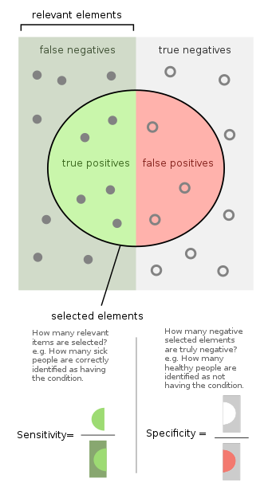
Sensitivity and specificity
Sensitivity (true positive rate) is the probability of a positive test result, conditioned on the individual truly being positive.
HIGH SENSITIVITY = high probability that a sick subject will test positive; = low probability that a sick subject will test negative.
Higher sensitivity means low risk of false negative!
Specificity (true negative rate) is the probability of a negative test result, conditioned on the individual truly being negative.
HIGH SPECIFICITY = high probability that a healthy subject will test negative; = low probability that a healthy subject will test positive
Higher specificity means low risk of false positive!

Slide 10
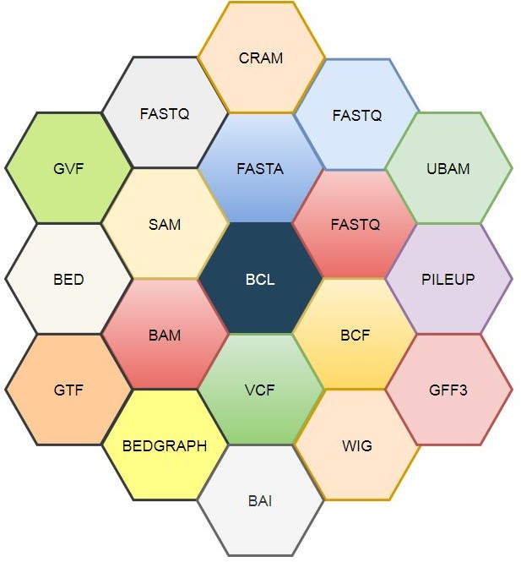
Files And Formats

Slide 11
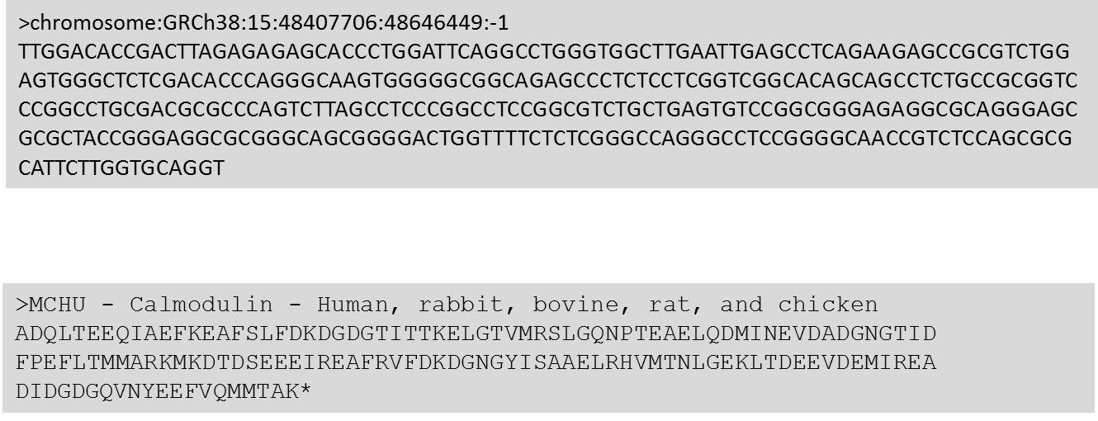
Introduction:
FastA format
It’s a standard format to indicate the DNA or protein sequence born in 1985. The term stands for "FAST-All" it’s Generally indicated with .fasta .fa. The ﬁle contains sequences with a header starting with '>' Each row consists of 60-70 or 80 bases.

Slide 12
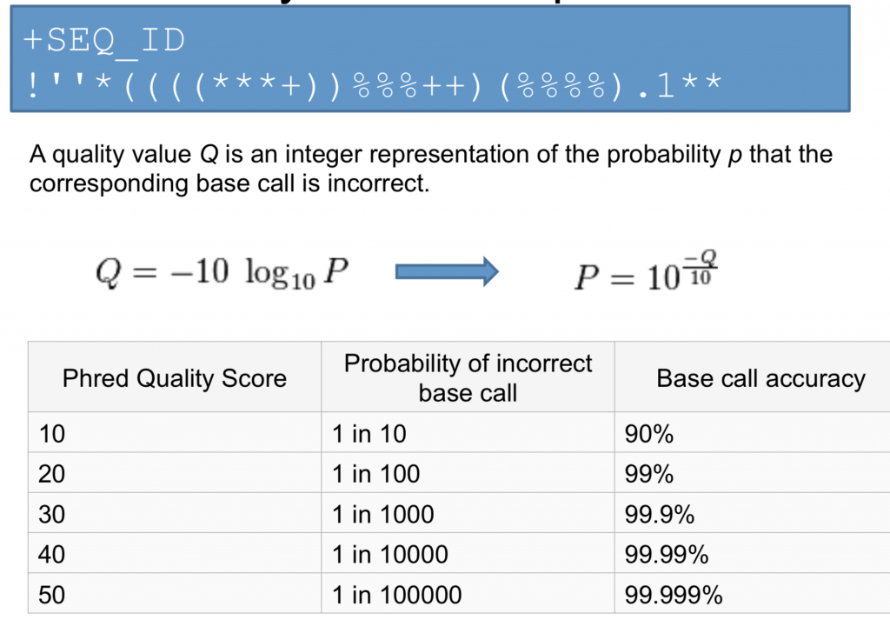
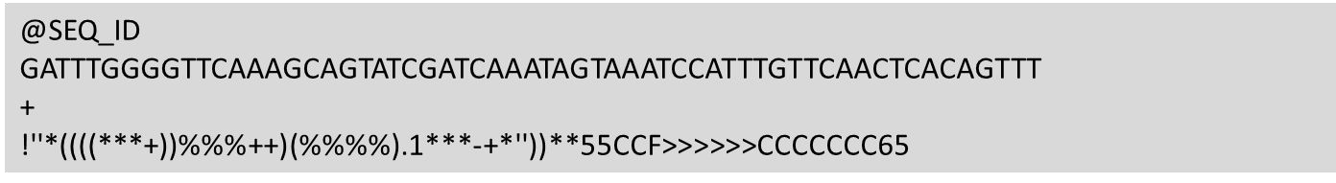
FastǪ format
FASTǪ format is a text-based format for storing both a biological sequence (usually nucleotide sequence) and its corresponding quality scores. Both the sequence letter and quality score are each encoded with a single ASCII character for brevity.
The quality score is indicated as PHRED Score
FastǪ

Slide 13
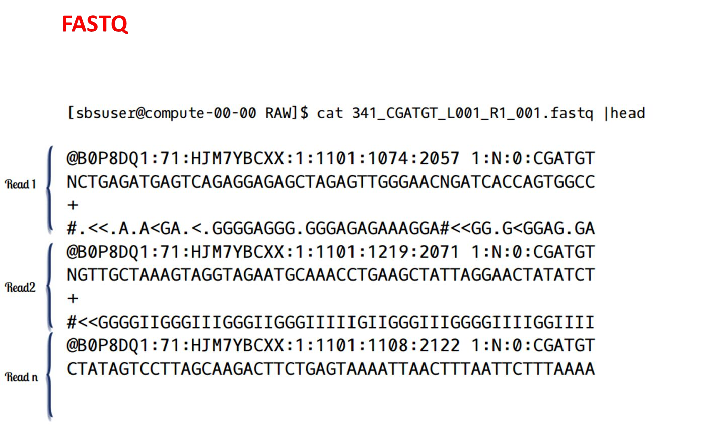

Slide 14
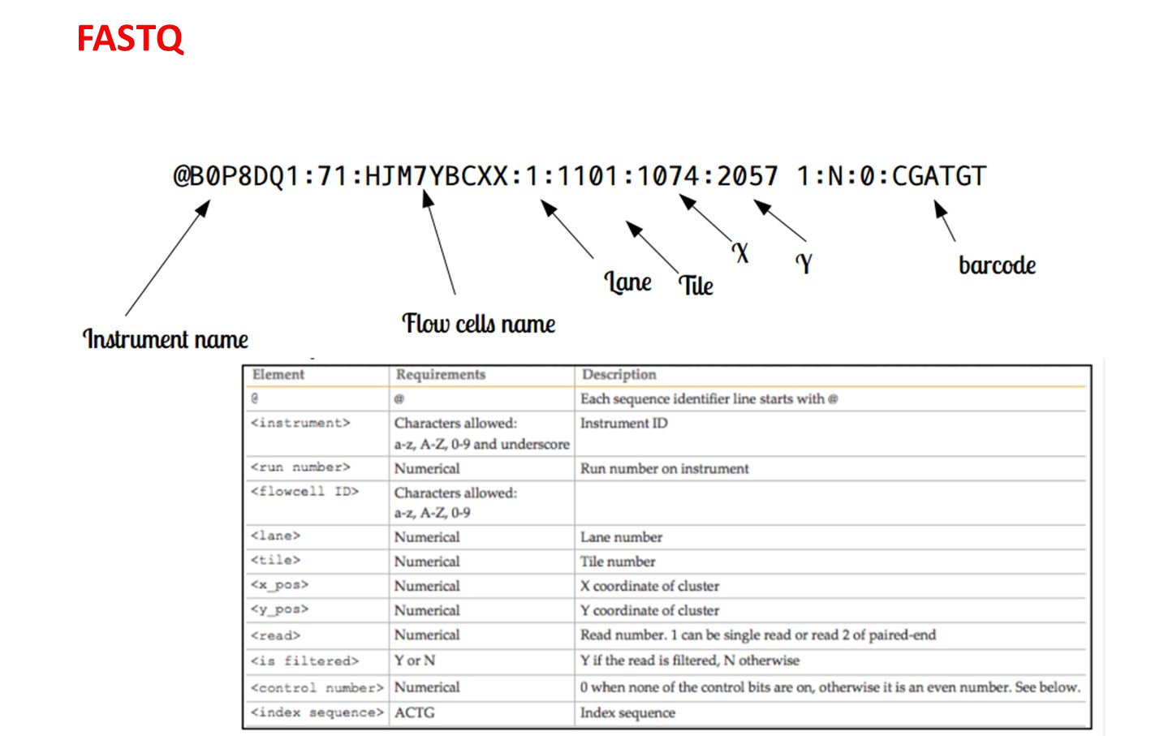

Slide 15
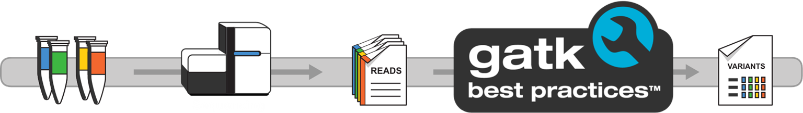

From samples to sequencing to analysis
.fastq
.bam /
.sam /
.cram
.vcf

Slide 16
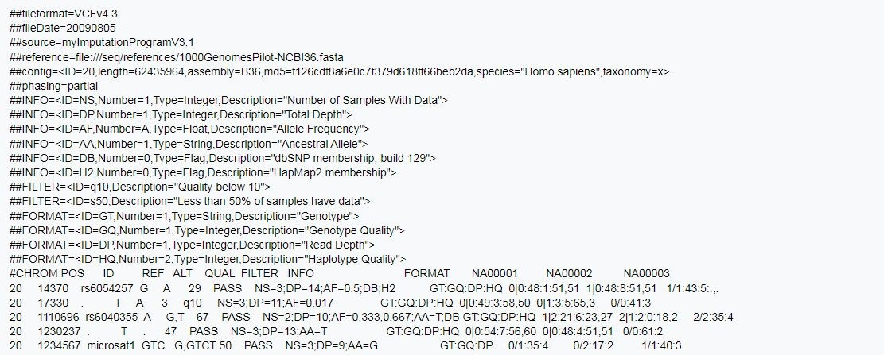
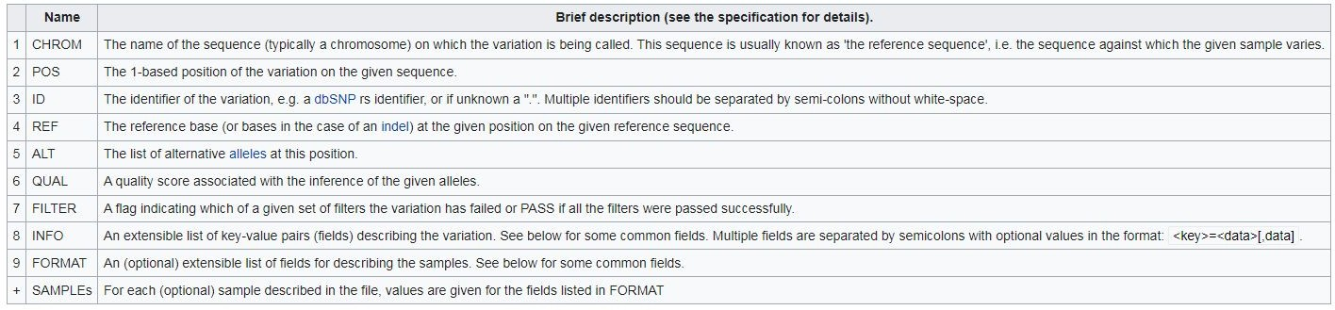
VCF format
VCF is a text ﬁle format. The name stands for Variant Call Format and it contains meta-information lines, a header line, and then data lines each containing information about a position in the genome. The format also has the ability to contain genotype information on samples for each position.

Slide 17
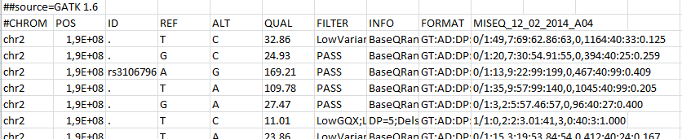
VCF FILE

Slide 18
WHAT IT MAY BE IMPORTANT TO KNOW ABOUT A GENETIC VARIANT
ITS GENOMIC POSITION
THE GENE INVOLVED
IF IT IS EXONIC OR NOT
HOW IT IS FREǪUENT IN THE POPULATION
WHAT KIND OF AMINO ACID ALTERATION IT PRODUCES
IF IT IS CONSERVED
KNOW HOW MUCH IT CAN ALTER THE PROTEIN
IF IT IS A KNOWN PATHOGENIC MUTATION

Slide 19
There are tools that allow you to intersect all this information and to merge the VCF files reporting the variants we have found and the data available about them.
THIS OPERATION IS CALLED
ANNOTATION

Slide 20
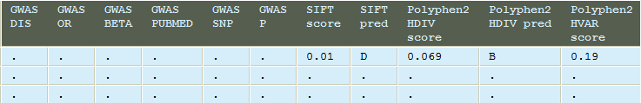
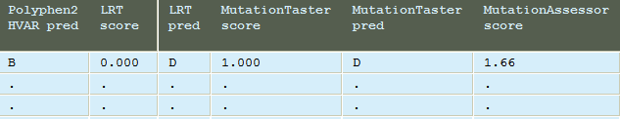
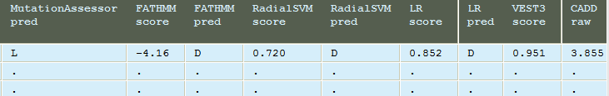
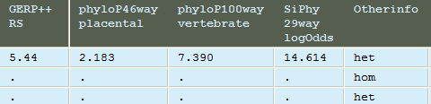
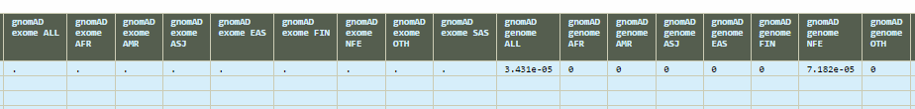

Slide 21
Filtering Genetic Variants
Consider the prevalence of the disease (different from incidence).
Consider the model of inheritance ( Dominant or recessive )
Make a calculation on the potential Heterozygotes/Homozygotes present in
the population.
Identify a threshold for the MAF
Consider the penetrance of the disease. And adjust the threshold for the MAF

Slide 22
Filtering Genetic Variants
Select only exonic and Splicing variants
Based on ExonicFunc.refGene field we exclude all variants that are synonimous
Exlude all variants reported in 1000G database and dbSNP
Exclude all variants reported as benign in ClinVar_SIG
Exlude all variants reported in gnomAD with a MAF
Prediction tools ( pay attention )

Slide 23
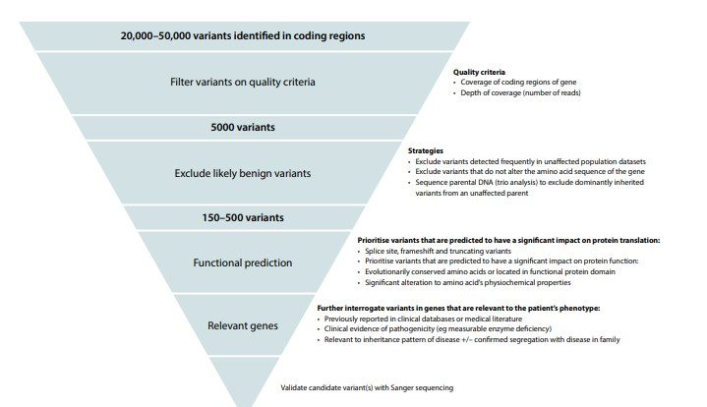
Filtering Genetic Variants

Slide 24

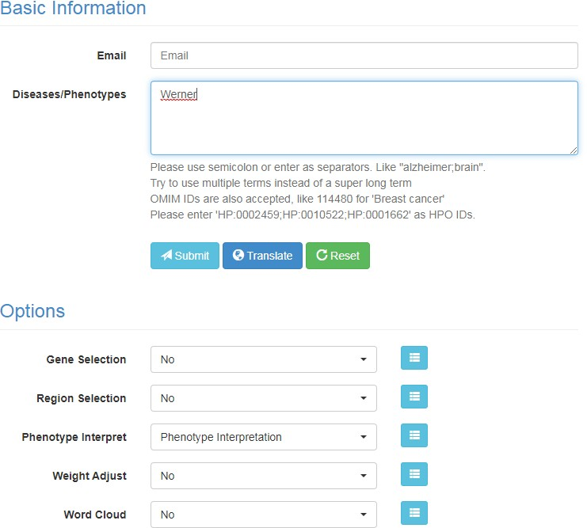
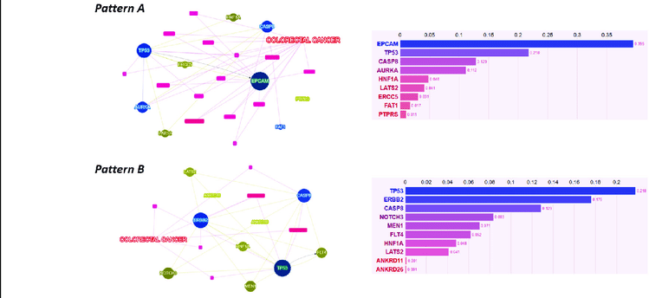
Filtering Genetic Variants
Prioritization of Genes

Slide 25
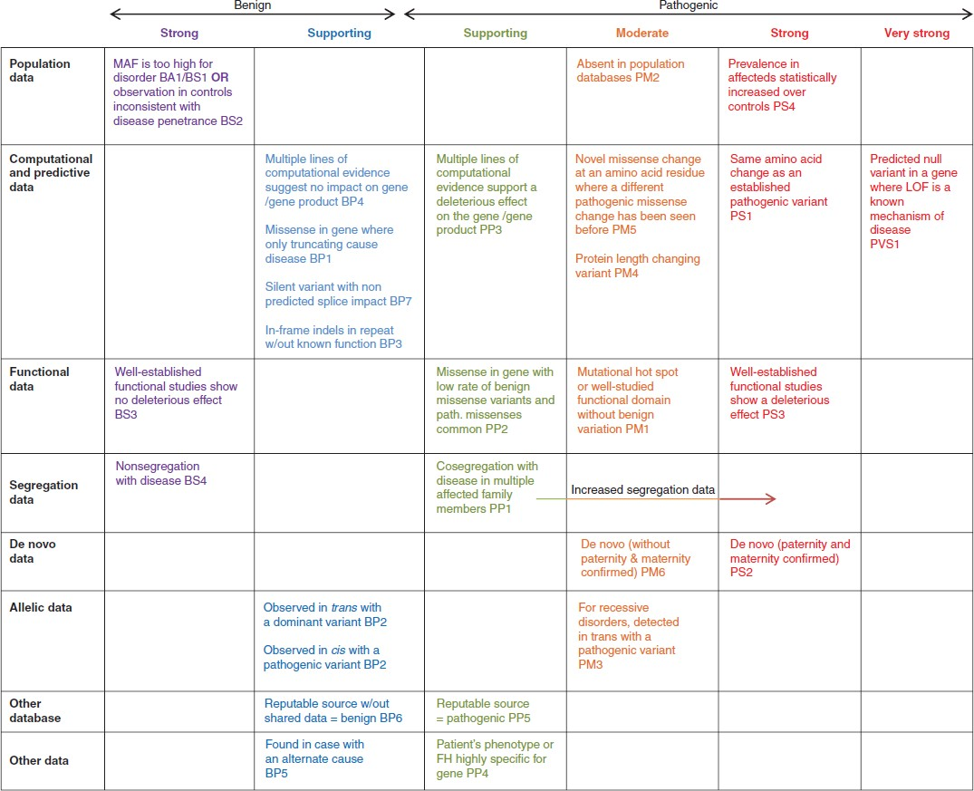
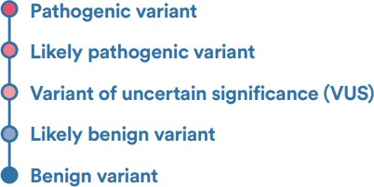
Filtering Genetic Variants

Slide 26
Filtering Genetic Variants
Benign:
The variant is not considered to be the cause of the tested disease
Main evaluation criteria
It is evident that the variant does not segregate with the disease in families with 2 or
more affected individuals
Or at least 4 points among these options
Control population minor allele frequency (eg, gnomAD) is considerable (MAF > 0.001) (prevalence of the disease must be taken into account)
Homozygous variant in a gene with no association to the disease.
Intact protein function observed in appropriate functional assay(s), eg,. a splice-region
variant without abnormal splicing
Co-occurrence with a pathogenic mutation in the same gene (phase unknown) or in another gene that clearly explains the proband’s phenotype
No disease association in small case-control study
Majority of the in silico tools predict the substitution to be benign.

Slide 27
Filtering Genetic Variants
Likely Benign:
The variant is not considered to be the cause of the tested disease
Main evaluation criteria
Control population minor allele frequency (eg,gnomAD) is considerable (MAF > 0.001)
(disease prevalence must be taken into account)
or at least 2 points
MAF < 0.001 in control populations but the variant is detected in healthy controls with no disease association in a case-control study/studies
Homozygous variant in a gene with no association to the disease.
Intact protein function observed in appropriate functional assay(s), eg,. a splice-region
variant without abnormal splicing
Co-occurrence with a pathogenic mutation in the same gene (phase unknown) or in another gene that clearly explains the proband’s phenotype
Majority of the in silico tools predict the substitution to be benign.

Slide 28
Filtering Genetic Variants
Variant of uncertain significance (VUS):
The variant has characteristics of being an independent disease-causing mutation, but insufficient or conflicting evidence exists
Main evaluation criteria
The variant is typically very rare, predicted to be deleterious, and the gene has an association with the patient’s phenotype.

Slide 29
Filtering Genetic Variants
Likely pathogenic variant
The identified variant is considered the probable cause of the patient’s disease.
Main evaluation criteria
A clear genotype-phenotype correlation exists. In these cases, it is essential to have thorough background information from the referring clinician about the patient’s phenotype, which helps to determine the probable pathogenicity.

Slide 30
Filtering Genetic Variants
Likely pathogenic variant
The identified variant is considered the probable cause of the patient’s disease.
Additional criteria are: at least 2 points
Alterations resulting in premature truncation (eg, frameshift, nonsense, or consensus splice site (+/-1, 2) in a gene where loss of gene function has been established as a mechanism of pathogenicity for the patient’s disease.
Variant is novel or very rare in control populations (cannot be applied for ethnic backgrounds absent from control populations).
Clear genotype-phenotype correlation exists (eg, MfS and FBN1)
Missense variant predicted deleterious by a majority of in silico tools applied
A variant predicted to have an effect to the splicing by majority of in silico tools applied
Variant has been identified in ≥2 individuals (one of which can be the current patient) with the same disease manifestation
Deficient protein function in appropriate functional assay(s)
Well-characterized mutation at the same codon or same splice consensus site

Slide 31
Filtering Genetic Variants
Pathogenic variant
The variant is considered the cause of the patient’s disease.
Main evaluation criteria
The variant is well established as disease causing in the databases and literature, and a wide consensus on the variant pathogenicity exists. In these cases, significant family segregation has been verified and several publications support pathogenicity
or at least 5 points
Variant is novel or very rare in control populations
Loss of gene function has been established as a mechanism of pathogenicity
A missense variant predicted deleterious by a majority of in silico tools applied
De novo alteration in the setting of a novel disease in the family
Variants considered deleterious in consensus splice site
Deficient protein function in appropriate functional assay(s)
Well-characterized other mutation at the same codon

Slide 32
Filtering Genetic Variants
Evidence Based Categorization of Somatic mutation
Unlike the interpretation of germline mutations which focuses on their pathogenicity in a specific clinical setting, in the case of somatic mutations, the interpretation should be focused on their impact in clinical practice. A somatic variant can in fact be considered a biomarker
If it predicts sensitivity or resistance to therapy
If it impairs the function of a gene target of a therapy
If it serves as an inclusion criterion for a trial
If it affects the prognosis
If it helps diagnose cancer
If it helps detect the presence of the tumor or residual disease

Slide 33
Filtering Genetic Variants
Rare Variants and Problems with medical reporting
NO RELEVANT GENE VARIANT FOR THE PHENOTYPE
ONE OR MORE KNOWN AND PATHOGENIC VARIANTS IN GENES COMPATIBLE WITH
CLINICAL INDICATIONS
ONE OR MORE VARIANTS ONLY POTENTIALLY PATHOGENIC IN GENES COMPATIBLE WITH CLINICAL INDICATIONS
ONE OR MORE KNOWN AND PATHOGENIC VARIATIONS IN GENES NOT COMPATIBLE
WITH CLINICAL INDICATIONS
ONE OR MORE VARIATIONS ONLY POTENTIALLY PATHOGENIC IN GENES NOT COMPATIBLE WITH CLINICAL INDICATIONS

Slide 34
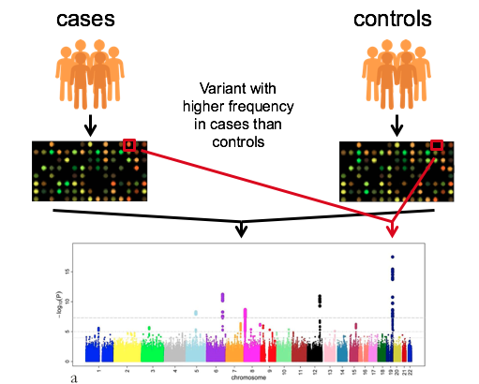
Genome-Wide Association Studies
Many methods for associating variants with a phenotype, trait or disease rely on the fact that a variant leading to a phenotype is found at a higher frequency in cases (individuals with the phenotype) than controls (individuals without the phenotype).
Genome wide association studies (GWAS) involve genotyping individuals at common variants across the genome using genome wide SNP arrays. Variants associated with trait, or within the same haplotype as a variant associated with a trait, will be found at a higher frequency in cases than controls.

Slide 35
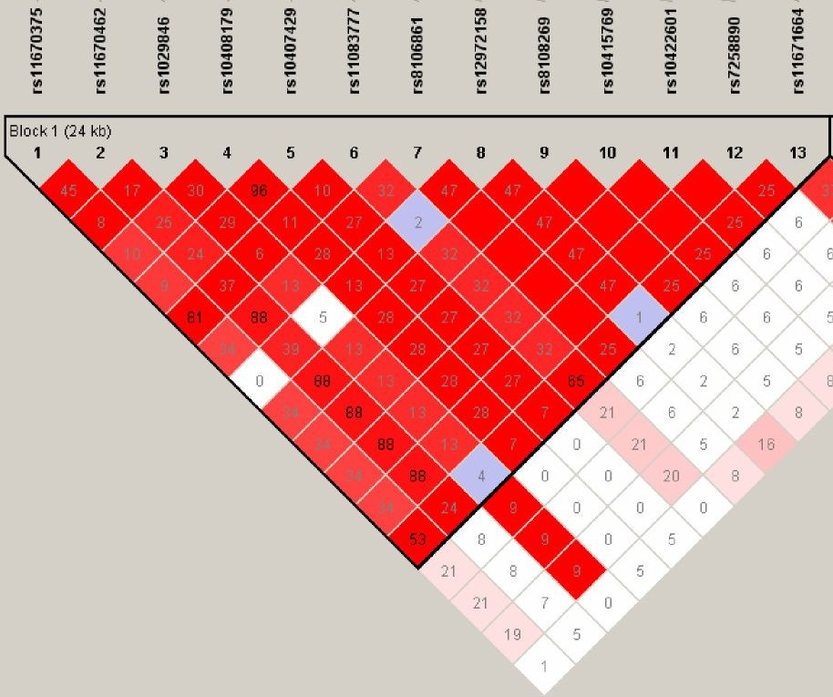
Which SNPs may i genotype?
It’s not necessary to genotype all SNPs in a genome. Using linkage disequilibrium we could collect all the information.
With specific tag-SNPs it’ possible to collect the information of 2M of SNPs.
A correct density could cover the entire genome. (first array 100k, average array 450k/600k probes)

Slide 36
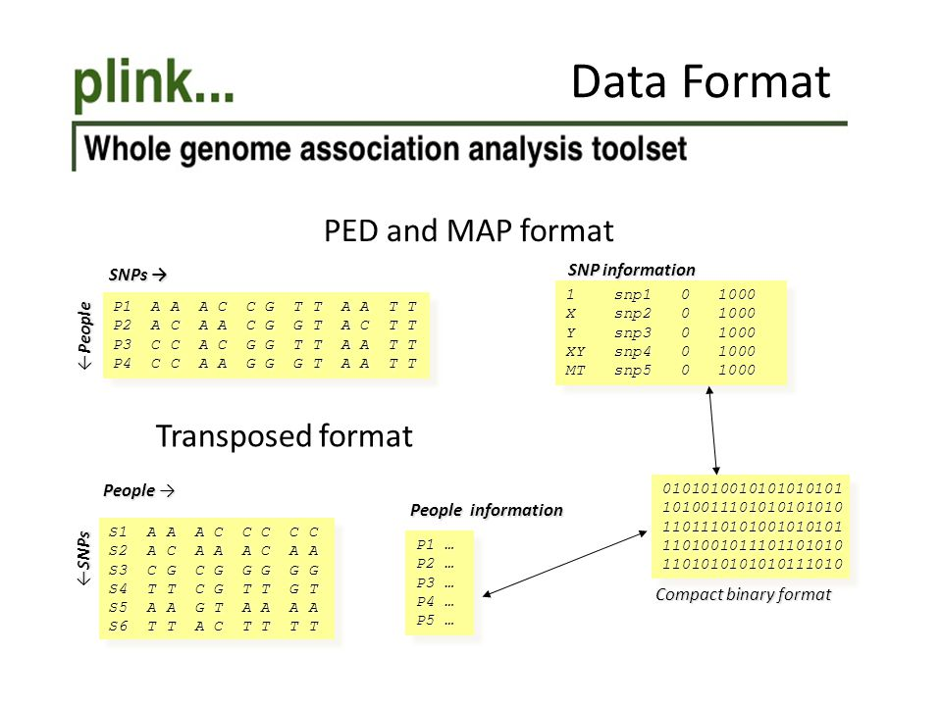

Slide 37
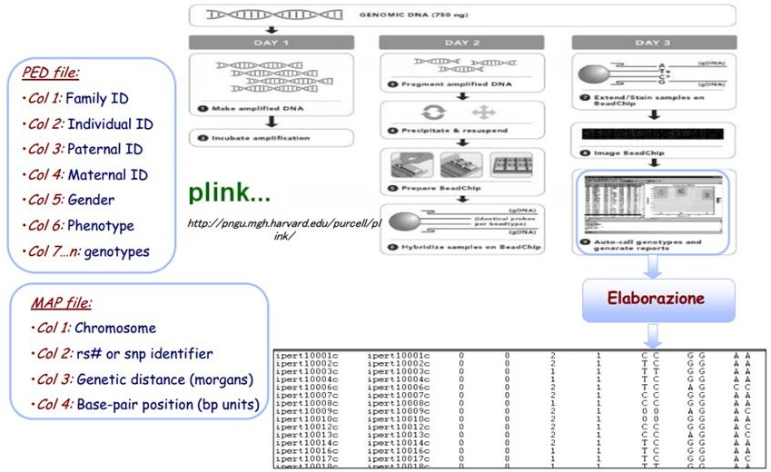

Slide 38
How to analyze: quality control
#conversion to bed format (NB not a genomic bed!!!!)
plink --ped file.ped --map file.map --make-bed --out file
#sex mistake check:
plink --bfile file --check-sex --out file
#phenotype sex is compared to genotype sex, samples not corresponding will then removed.

Slide 39
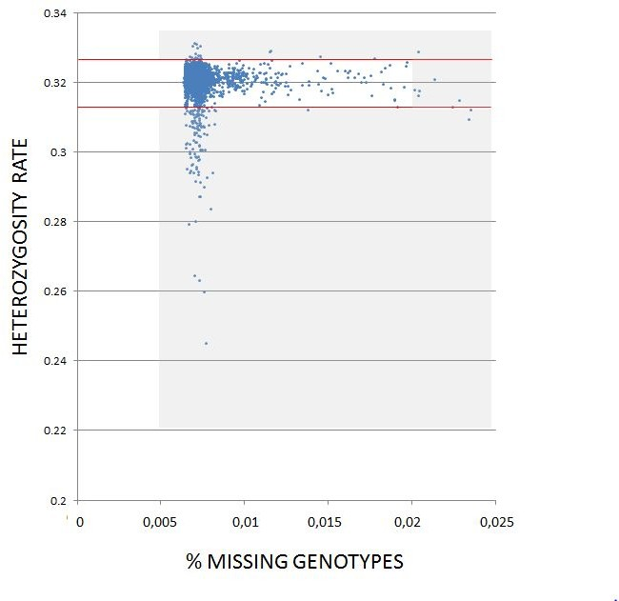
How to analyze: quality control
#remove SNPs missing or bad genotyped:
plink --bfile file -–missing --out file
#2 files produced: lmiss and imiss
#Het check (CI calcolation):
plink --bfile file --het --out file

Slide 40
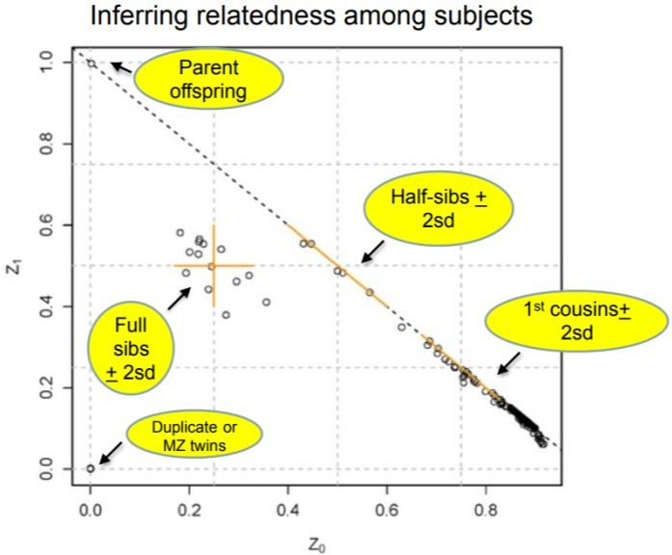
How to analyze: quality control
#IBD check:
IBD probabilities are calculated:
Z0 = P(share 0 IBD alleles)
Z1 = P(share 1 IBD allele)
Z2 = P(share 2 IBD alleles)
Plotting Z0 vs. Z1 we can identify related individuals
REMOVE INDIVIDUALS THAT FAILS ALL THESE TESTS!!!!!

Slide 41
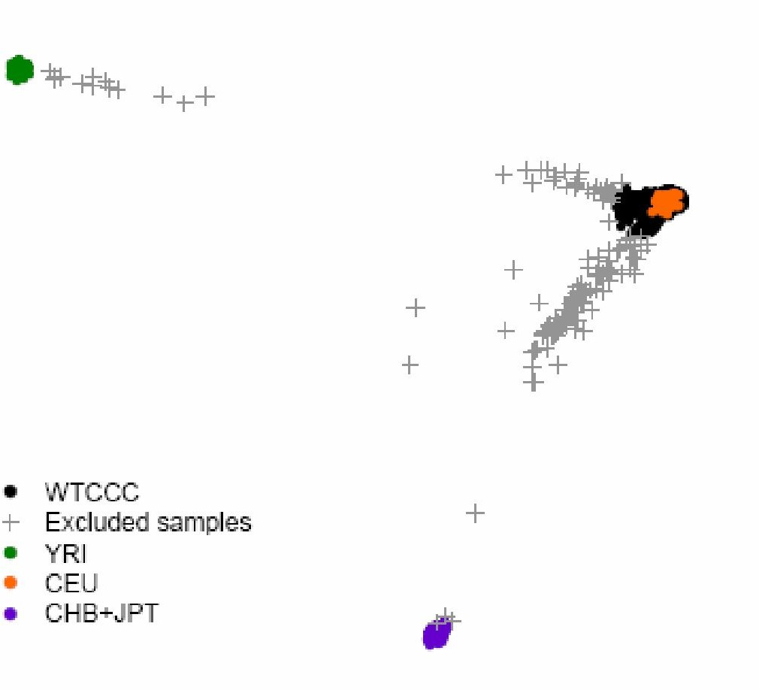
How to analyze: quality control
#BACKGROUND NOISE: POPULATION STRATIFICATION!
PCA of UK population:
remove all samples not from a specific population (EIGENSTRAT pipeline)

Slide 42
Ready to test the association:
#Plink2 has retired --assoc command, the new pipeline:
plink2 --pfile mydata \
--glm genotypic interaction \
--covar tmp.cov #age and sex, usually
There are additional parameters that take into accounts the additive effect or dominance deviation!
EXPECTED OUTPUT:
CHR: the chromosome number of the SNP
SNP: the identifier of the SNP
BP: the physical position of the SNP on the genome map
A1: the reference allele (in apostrophe) for the SNP
A2: the alternate allele (in apostrophe) for the SNP
NMISS: the number of subjects who do not have a missing value for the SNP
BETA: the estimated coefficient for the SNP (on a logarithmic scale)
SE: the standard error for the estimated coefficient
L95: the lower limit of the 95% confidence interval for the estimated coefficient
U95: the upper limit of the 95% confidence interval for the estimated coefficient
STAT: the value of the Wald test for the SNP
P: the p-value associated with the Wald test for the SNP. A significant p-value indicates that there is an effect of the SNP on the phenotype! But not the only one!!!!

Slide 43
TIPS: PLINK2.0 allows recoding VCF
Basic syntax:
plink --vcf my.vcf --make-bed --out out.vcf
….ERROR???? What can we do?
Large NGS file often contains extra contig, in this case use “--allow-extra-chr” parameter
https://www.cog-genomics.org/plink/2.0/

Slide 44

Sequencing and Introduction to Hail: Overview
Credits to the valuable work of:
Kumar Veerapen, PhD

Slide 45


Learning Objectives
To understand the overview of DNA sequencing methods
To capture the need for Hail in the analysis of genomic datasets
To be able to use basic Hail functions
To apply basic GWAS analysis techniques using Hail on their own datasets
To describe the use of PCA in Hail to decipher ancestries
To obtain resources to further explore the extent of Hail capabilities
To learn how to use Hail on public compute clouds

Slide 46
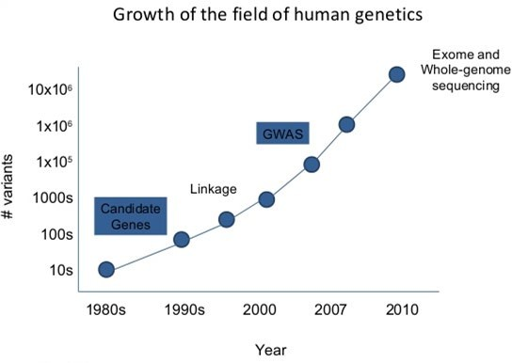
Technological Growth in Genetics and Genomics
Adapted from: Lekki Wood. Baylor College of Medicine. Slideshare.net

Slide 47
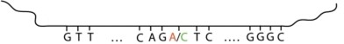

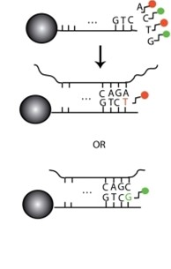
Genotyping chip
Single nucleotide polymorphism arrays:
a decade of biological, computational and technological advances
Hailiang Huang, MGH

Slide 48
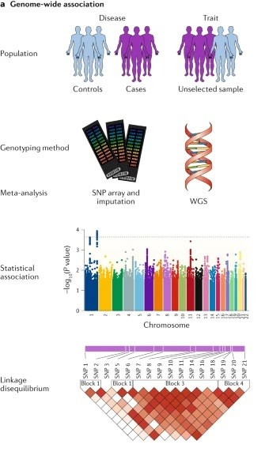
Tam et al (2019). Nat Gen Rev

Slide 49
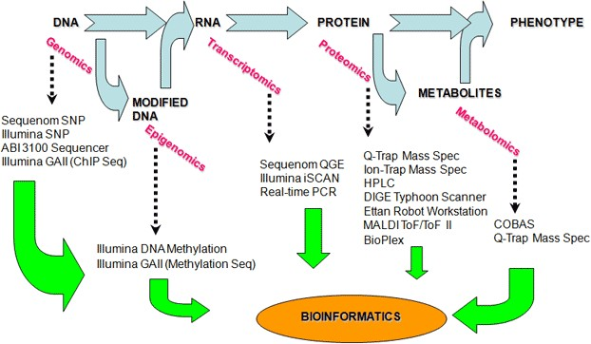
Overview: -Omics

Slide 50
Learning Objectives
To capture the need for Hail in the analysis of genomic datasets
Why Hail?
What can you use Hail for?

Slide 51
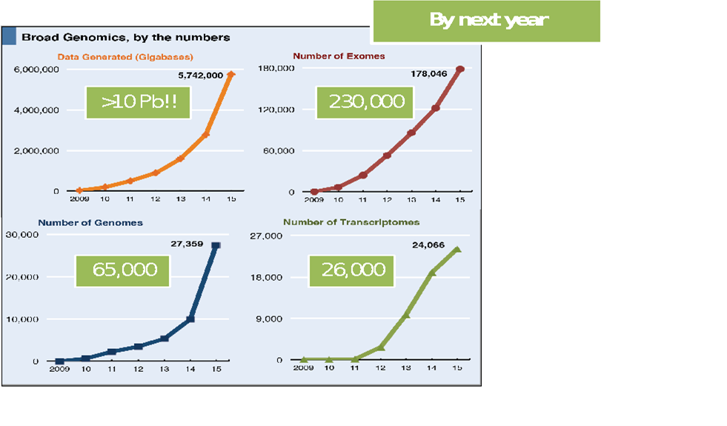

Accelerating Genomic Data e.g. Call Sets, variant files etc

Slide 52
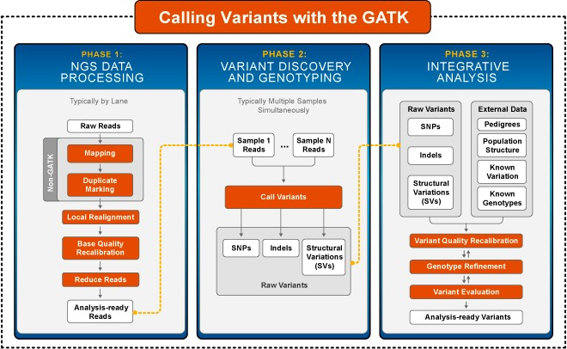
What is Hail’s role in callset generation?
.vcf file

Slide 53
What is Hail?
“On a scale from zero to dplyr, the Hail 0.2 interface scores an 8/10 for general-purpose data analysis.” - Konrad K., lead analyst, gnomAD
Open-Source Data Science Library
Learn more at Hail.is
*We can’t read your minds, so talk to us
discuss.hail.is
Slice, dice, query, and model any kind of data
Scalability
Easy to use with both small and biobank-scale genomic data
Unified Genomic Data Representation
The MatrixTable is a single interface for working with all kinds of genomic data
Community
Forum and chatroom for people interested in thinking + talking about genomic data analysis

Slide 54
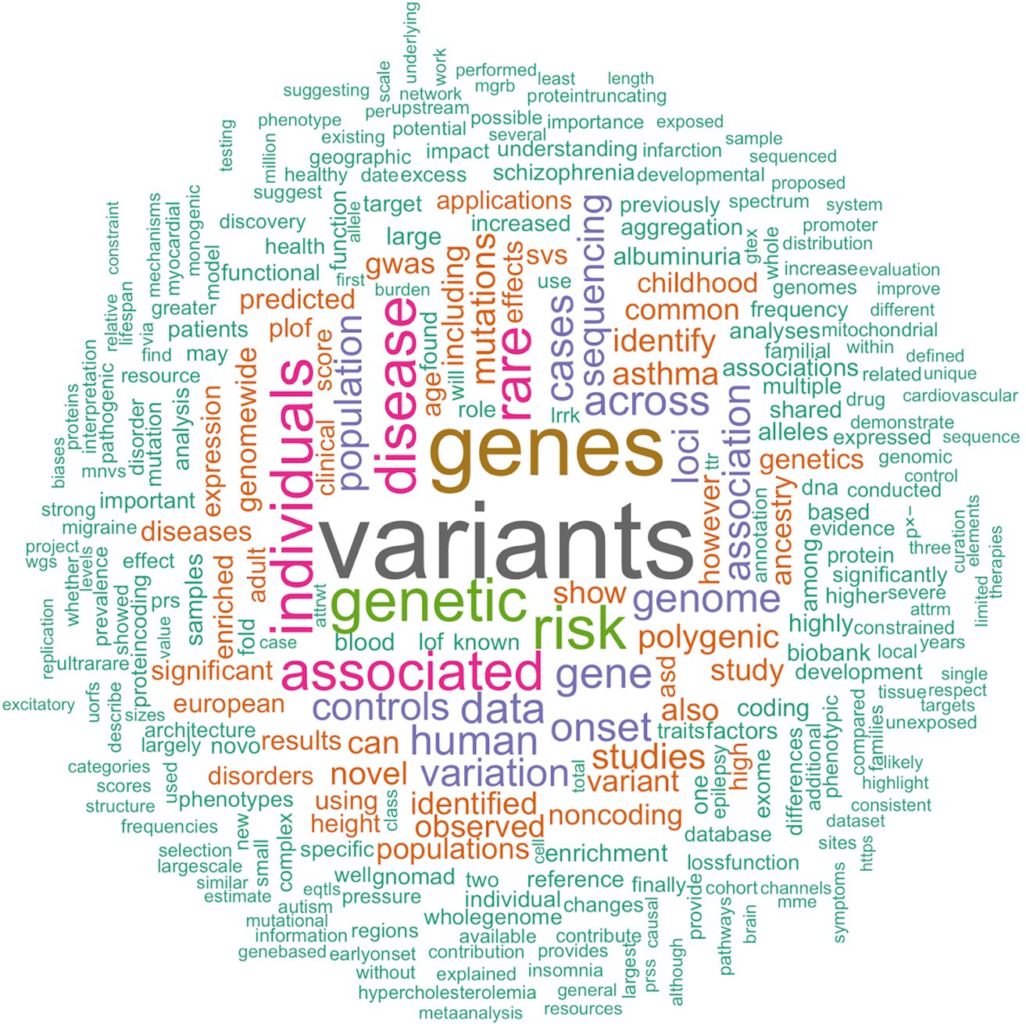
How has Hail been used? (hail.is/references.html)
Notes:
51 abstracts (07/20/2020)
Word appearing > 4x

Slide 55
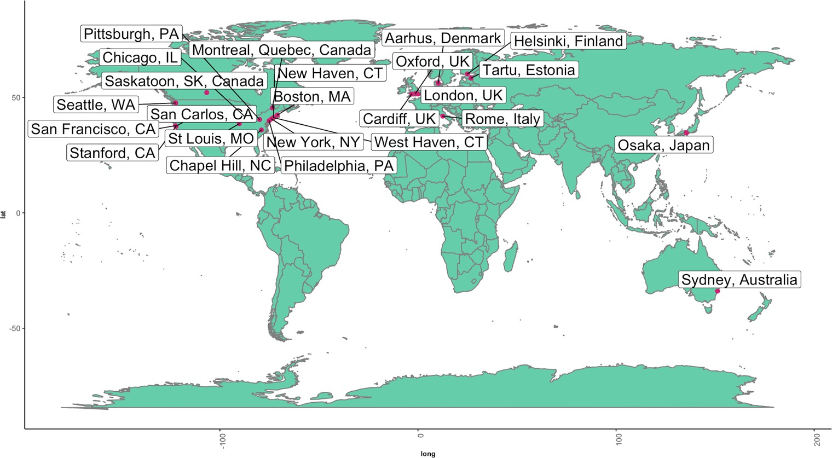
Where has Hail been used?
~28% is from Boston, MA

Slide 56
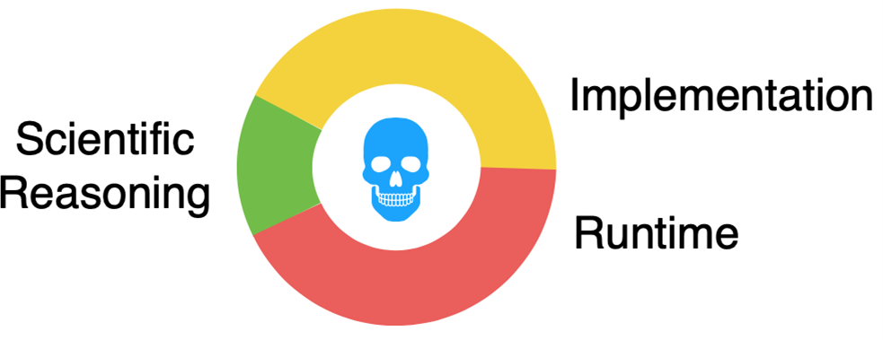

Why would you use Hail?

Slide 57
Hail as a data science library
Data slinging
Analytical toolbox

Slide 58
Hail as a data science library
Data slinging
Analytical toolbox
Read and write common formats
VCF
TS V
Filter, group, aggregate
BGEN
P LINK
Annotation
Visualization
J SON
GEN
BED
GTF

Slide 59
Hail as a data science library
Data slinging
Ana lytic al toolb ox
Read and write common formats
Filter, group, aggregate
Annotation
Visualization
Compute mean depth per variant or per samp le
Among heterozygotes
Grouped by ancestry lab e ls & sex
Count trans itions & transvers ions ca lled per samp le

Slide 60
Hail as a data science library
Data slinging
Ana lytic al toolb ox
Read and write common formats
Filter, group, aggregate
Annotation
Visualization
Built-in wrapper for the Va riant Effect Pred ic tor (VEP ). We d id the setup so you don’t have to!
J oin with annotations by varia nt, loc us, inte rva l, gene
Annota tion database

Slide 61
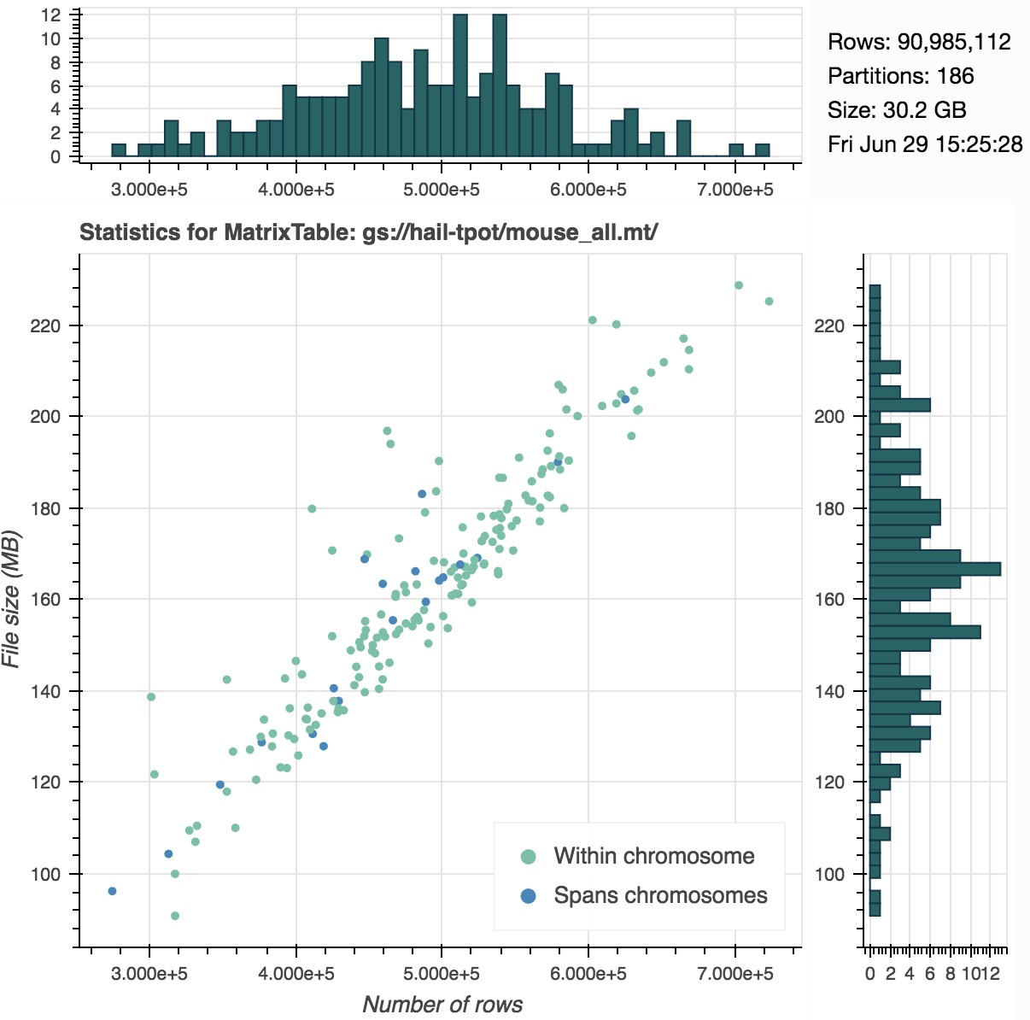
Hail as a data science library
Data slinging
Ana lytic al toolb ox
Read and write common formats
Filter, group, aggregate
Annotation
Visualization

Slide 62
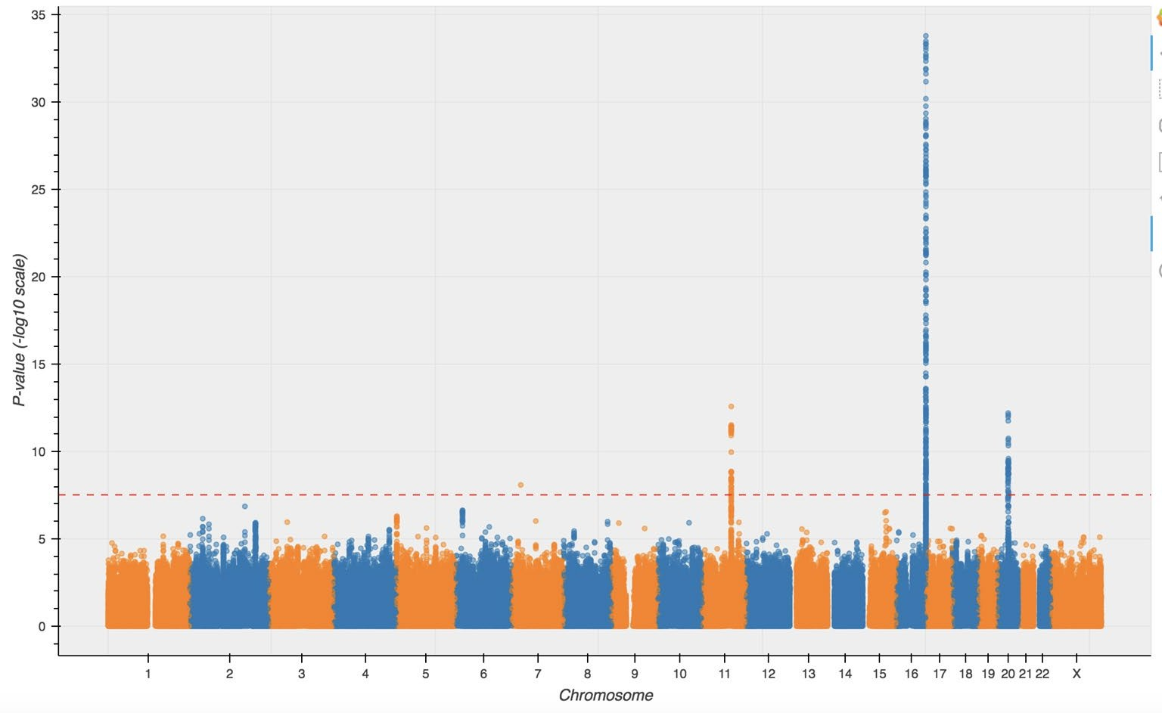
Hail as a data science library
Data s linging
Analytical toolbox
Statistical methods for genetics
Linear regression
UK Biobank Rap id GWAS Ma lignant me lanoma
Linear algebra
UKBB Rapid
GWAS
association

Slide 63
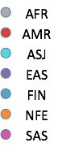
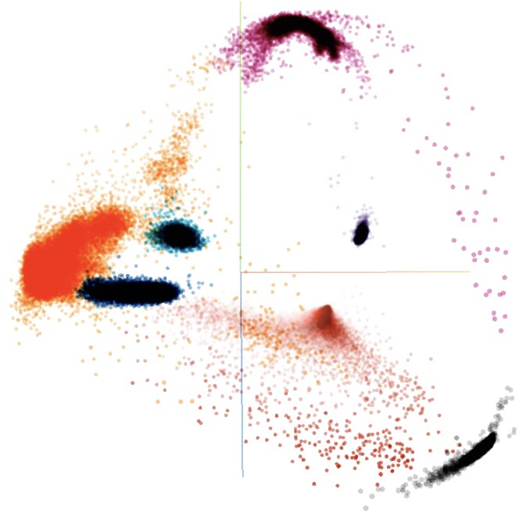
Hail as a data science library
Data slinging
Analytical toolbox
Statistical methods for genetics
Linear algebra
Genotype PCA
gnomAD

Slide 64
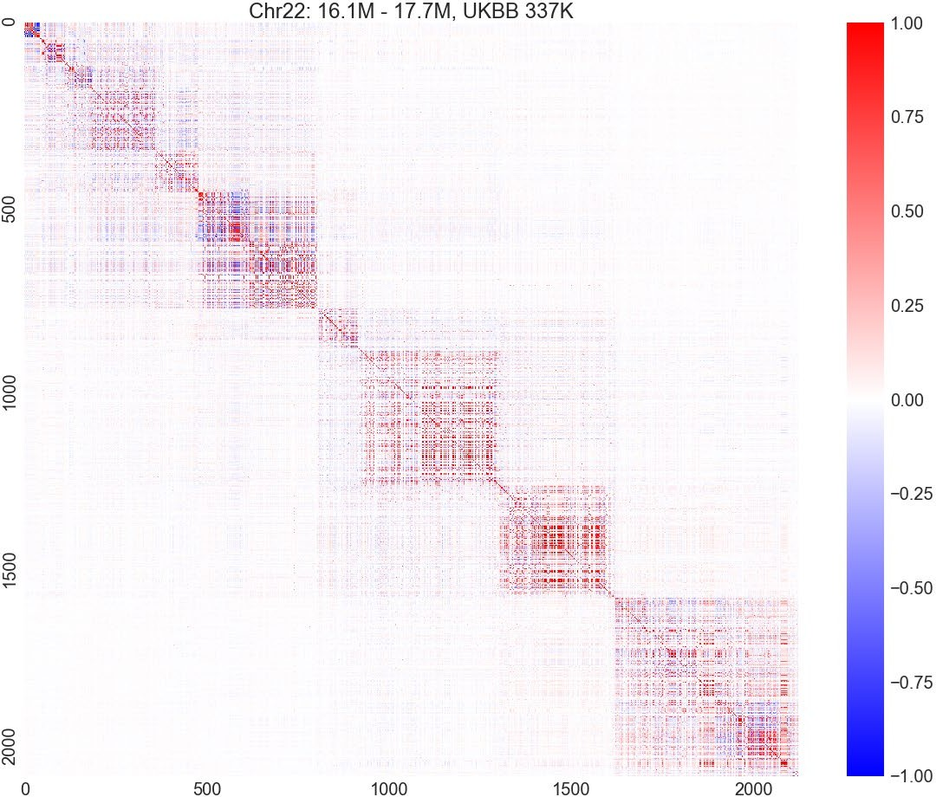
Hail as a data science library
Data slinging
Analytical toolbox
Statistical methods for genetics
Linear algebra (early stages)
Linkage disequilibrium UK Biobank

Slide 65
Variant Call Format (VCF)
samp le
…
ID
NA12878
…
genotypes
variant
…
GT | AD | DP | …
0/1 | 8,11 | 19 | …
…
CHROM | POS | RSID | REF | …
17 | 37282 | rs12345 | A | …

Slide 66
Rare variant aggregation
sample
…
ID
NA12878
…
counts
gene
…
N Loss -of - function | N Missense | N Synonymous
1 | 9 | 12
…
Gene
spectrin

Slide 67
Trio data
trio
…
Proband | Mother | Father | …
NA12878 | NA12891 | NA12892 | …
…
genotypes
variant
…
proband_GT | mother_GT | father_GT | …
0/1 | 0/0 | 0/0 | …
…
CHROM | POS | RSID | REF | …
17 | 37282 | rs12345 | A | …

Slide 68
Transcript expression
tissue sample
… …
expression
transcript
Sample | Tissue
NA12878 | Liver
…
Raw_expression | Norm_expression
2 | 4.1232
…
Transcript | Gene
ENSG00000128487 | spectrin

Slide 69
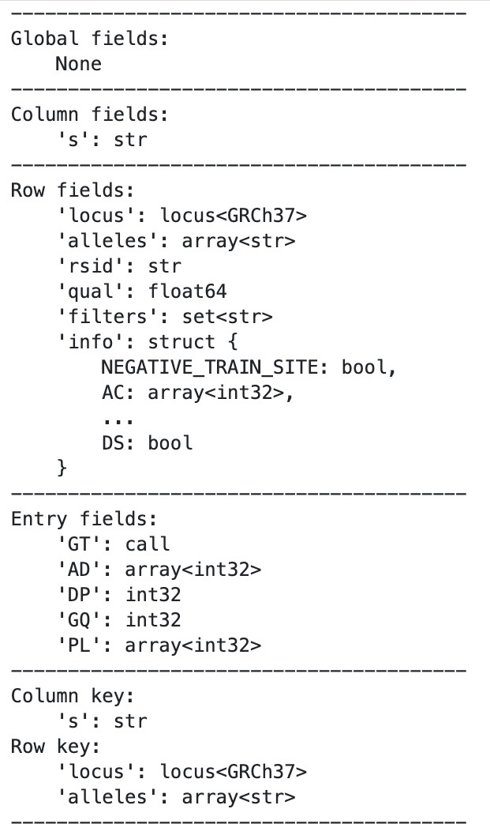
MatrixTable
cols
…
…
entrie s
rows
…
…
Can be extended to rare variant aggregation, trio, transcript expression

Slide 70
Table
MatrixTable
cols
rows
…
…
…
entrie s
rows
…
…
…
We have cheatsheets for this too! https://hail.is/docs/0.2/cheatsheets.html

Slide 71
Large-s ca le datasets
UK Biobank 500K => 5M?
… and many other biobanks
gnomAD: 20K => 150K WGS
TOPMed: >120K WGS
All of Us: 1M
Million Veterans Project: 1M
ALS COMPUTE

Slide 72
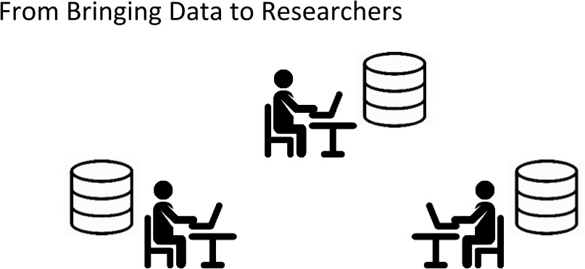

Slide 73


Slide 74
The cloud: pros and cons
Advantages:
Many researchers can work on the same data at no additional cost
No need to share resources with colleagues -- rent your own.
High computer utilization means good cost efficiency
Pay for lots of CPUs when you need them, and pay nothing when you don’t
Great security and fault-tolerance for data
Democratization: don’t need access to institutional HPC cluster to participate in research (though do still need funding)
Disadvantages:
Every operation has a cost, so an understanding of cost model is important
Difficult to know how many resources to provision
Too small a cluster, you waste your time. Too large a cluster, you waste money.
Cost overruns do happen
However, cloud providers will often refund accidental spend

Slide 75
Computational Landscape
Laptop/Desktop
pip install hail
Server, or a single node on High Performance Computing (HPC) cluster
pip install hail
High Performance Computing (HPC) cluster Institutional Spark cluster
Hail does not support HPC schedulers like SLURM, UGER, and LSF
Cloud
Google Cloud Platform (GCP):
pip install hail
hailctl dataproc start CLUSTER
Ama zon Web Services (AWS): some support
https://github.com/hms-dbmi/hail-on-AWS-spot-instances
https://discuss.hail.is/t/spin-up-aws-emr-clusters-with-hail/818

Slide 76




Your next steps
pip install hail
hail.is/docs/0.2/
blog.hail.is/
discuss.hail.is

Slide 77

best Hail support right now

Slide 78
Cloud computing products from Google
Google Storage (sometimes referred to as "Google Buckets")
Store data, Python notebooks, anything you want.
~$25 per TB per month.
Google Compute Engine (GCE)
Rent a virtual machine, use it however you want.
~$0.05 per CPU per hour for standard VMs
~$0.01 per CPU per hour for preemptible VMs
Google Dataproc
Rent a cluster running Apache Spark, which is Hail’s distributed computing engine.
GCE price, plus $0.01 per CPU per hour.

Slide 79
hailctl, the manager for Hail on the cloud
hailctl = “hail control”
hailctl dataproc is the Hail cloud manager for Google.
hailctl emr (Amazon) and hailctl azure (Microsoft) planned.
Common cluster operations:
hailctl dataproc start MYCLUSTER --max-age 4h hailctl dataproc connect MYCLUSTER notebook hailctl dataproc submit MYCLUSTER script.py hailctl dataproc stop MYCLUSTER
https://hail.is/docs/0.2/cloud/google_cloud.html#hailctl-dataproc

Slide 80
gsutil, file manager for Google Storage
gsutil = Google Storage Utilities
Amazon and Microsoft clouds have their own analogs.
Create a new bucket (root directory)
gsutil mb gs://mybucket
List files in a bucket:
gsutil ls gs://mybucket
gsutil ls gs://mybucket/subfolder
Copy data to/from the cloud
gsutil cp gs://mybucket/file /Users/me/data/file gsutil cp /Users/me/data/file gs://mybucket/file
https://cloud.google.com/storage/docs/gsutil

Slide 81
Cost management best practices
Develop small, run big
Iterate on pipelines using a piece of the full dataset (make chr22 your bestie)
Run pipelines on large clusters when ready
Manage risk
Set billing limits and alerts (you’ll get an email if you start to overspend)
Always use --max-age or --max-idle flags on cluster creation
Use Buckets with retention policies (data deleted after X days) when possible
Plan Ahead
Calculate costs ahead of time where possible
https://cloud.google.com/products/calculator/
https://hail.is/docs/0.2/cloud/general_advice.html

